Slide 1

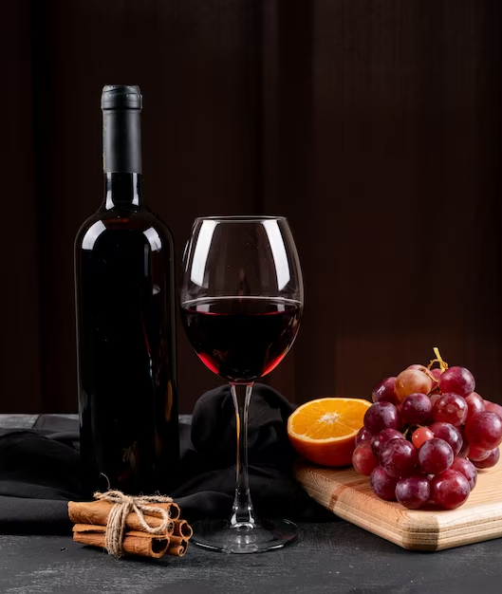
RED WINE
QUALITY
ANALYSIS

Slide 2




OBJECTIVE
Analysing dataset to bring meaningful insights from features on the red wine quality dataset
1
Evaluate and compare the performance of different machine learning techniques to determine the most effective approach for red wine quality
2

Slide 3

FEATURES
Fixed acidity
Volatile acidity
Citric acid
Residual Sugar
Chlorides
Free sulfur dioxide
Total sulfur dioxide
Density
pH
Sulphates
Alcohol
Quality
Target Variable: Quality

Slide 4

ABOUT DATASET
There are 1599 Records/Rows and 12 Features/columns in the dataset.
All the features present in the dataset are numerical.
No Categorical Features are present in the dataset.
None of the features has missing values.
There are a total of 240 duplicate records which lead to Data Integrity issues so it's better to drop these records.

Slide 5

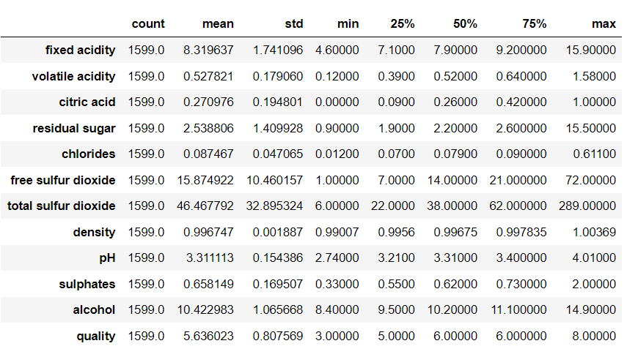
DESCRIBING THE DATASET

Slide 6
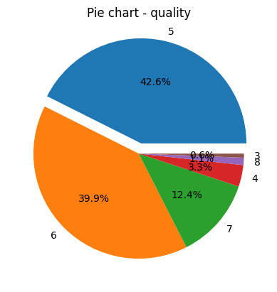
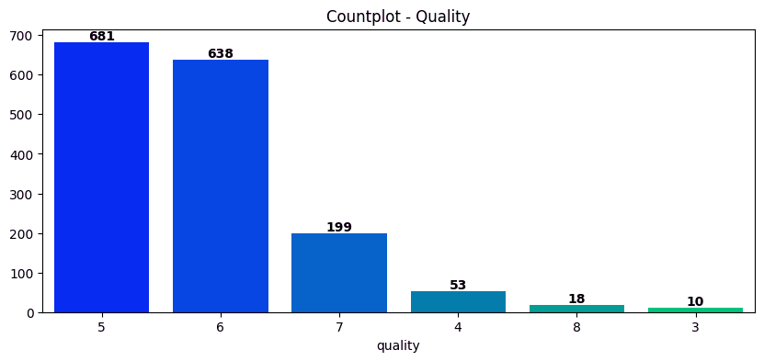
EDA
Quality

Slide 7
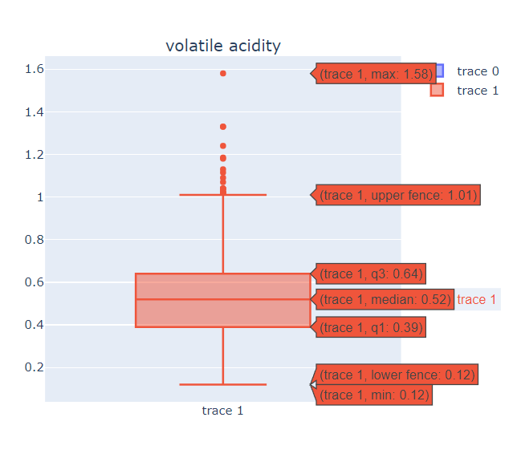
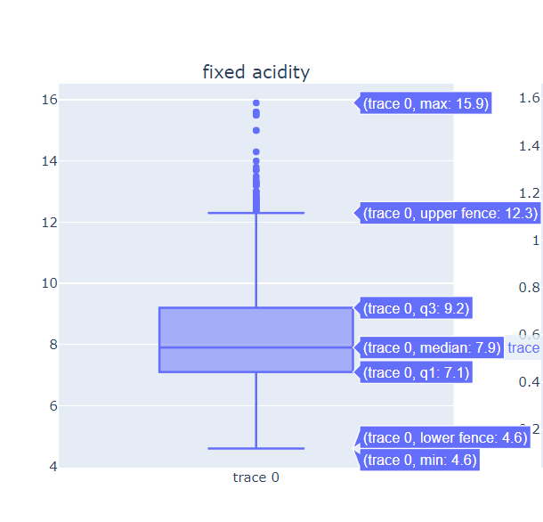
Fixed & Volatile Acidity

Slide 8
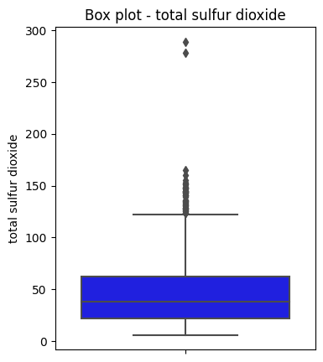
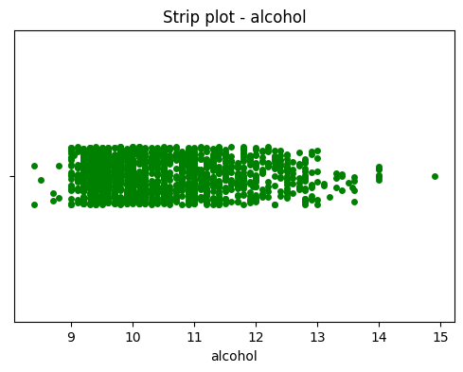

Slide 9
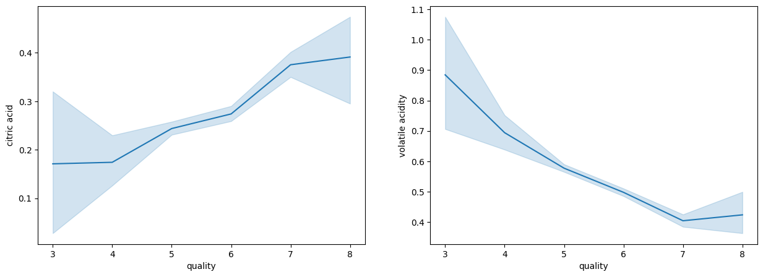
Citric Acid vs Quality
Volatile Acidity vs Quality

Slide 10
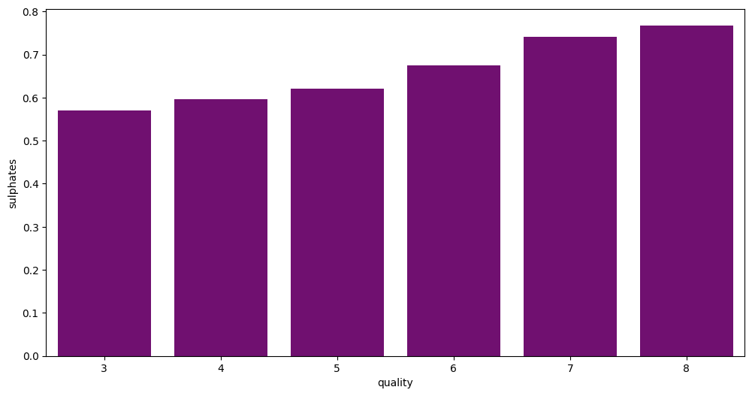
Sulphates vs Quality

Slide 11
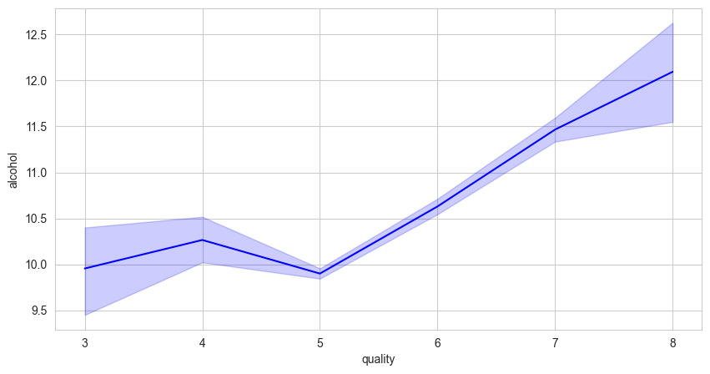
Alcohol vs Quality

Slide 12
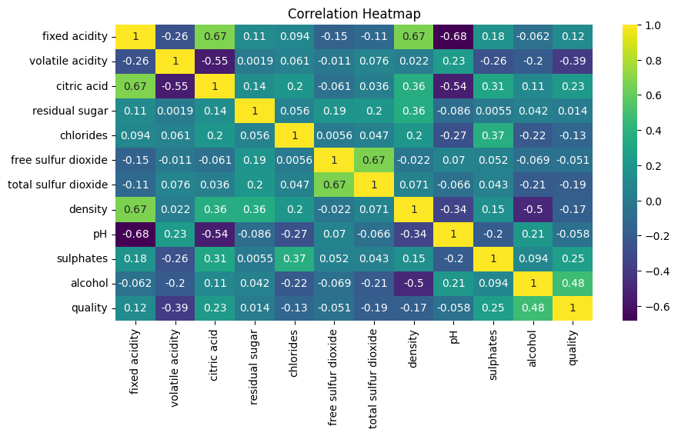
Heatmap

Slide 13
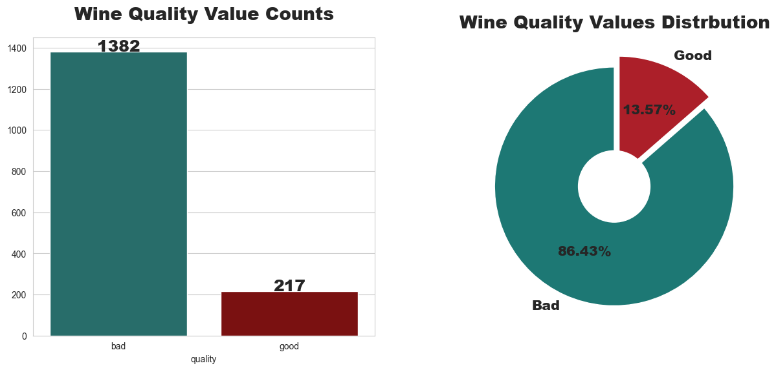
Number of Bad Wine vs Good Wine

Slide 14
MODELS USED
Logistic Regression
K-Nearest Neighbors
Random Forest Classifier
Decision Tree Classifier
Support Vector Classifier

Slide 15
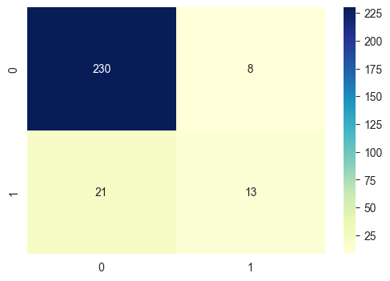
LOGISTIC REGRESSION
CLASSIFICATION REPORT
BAD WINE(0)
Precision - 0.92
Recall - 0.97
f1-score - 0.94
Support - 238
GOOD WINE(1)
Precision - 0.62
Recall - 0.38
f1-score - 0.47
Support - 34
Accuracy: 89.33%

Slide 16
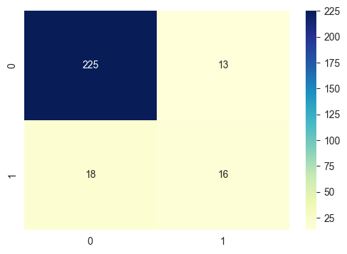
K-NEAREST NEIGHBORS
CLASSIFICATION REPORT
BAD WINE(0)
Precision - 0.93
Recall - 0.95
f1-score - 0.94
Support - 238
GOOD WINE(1)
Precision - 0.55
Recall - 0.47
f1-score - 0.51
Support - 34
Accuracy: 88.60%

Slide 17
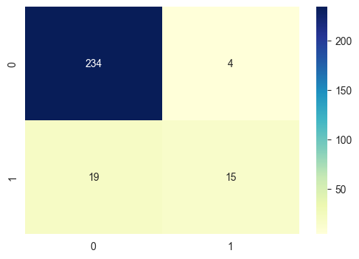
RANDOM FOREST CLASSIFIER
CLASSIFICATION REPORT
BAD WINE(0)
Precision - 0.92
Recall - 0.98
f1-score - 0.95
Support - 238
GOOD WINE(1)
Precision - 0.79
Recall - 0.44
f1-score - 0.57
Support - 34
Accuracy: 91.54%

Slide 18
DECISION TREE CLASSIFIER
CLASSIFICATION REPORT
BAD WINE(0)
Precision - 0.93
Recall - 0.92
f1-score - 0.92
Support - 238
GOOD WINE(1)
Precision - 0.46
Recall - 0.50
f1-score - 0.48
Support - 34
Accuracy: 86.39%

Slide 19
SUPPORT VECTOR CLASSIFIER
CLASSIFICATION REPORT
BAD WINE(0)
Precision - 0.93
Recall - 0.99
f1-score - 0.96
Support - 238
GOOD WINE(1)
Precision - 0.83
Recall - 0.44
f1-score - 0.58
Support - 34
Accuracy: 91.91%

Slide 20
CONCLUSION
The model demonstrates robust performance across multiple measurement parameters, indicating its effectiveness in accurately forecasting and capturing desired results.
The SVC model performs better than the above-used models, as the accuracy of SVC is 91.91% which provides the best fit for data

Slide 21

Thank You

